Slide 1

Week 2 Hands On Assignment - Data Wrangling Project
By Johnny DeGiorgio

Slide 2
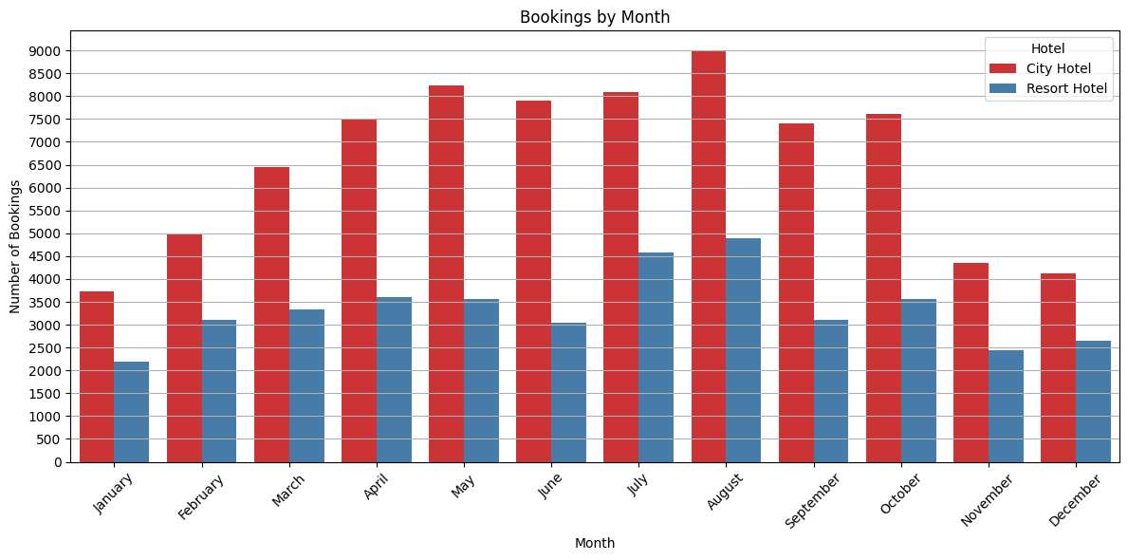

Slide 3
Bookings by Month
With this plot I wanted to see the booking for each hotel by month in order to pinpoint which were the busy and slow months. We have a pretty steady climb from January to August and then a steady decline to December. High month for both hotels is August and low month for both hotels are January.

Slide 4
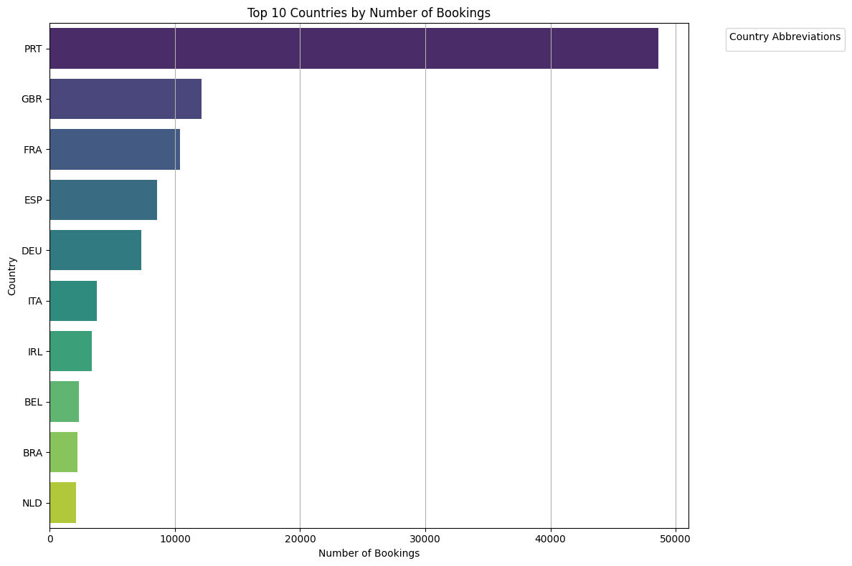
Puerto Rico: PRT
Great Britain: GBR
France: FRA
Spain: ESP
Germany: DEU
Italy: ITA
Ireland: IRL
Belgium: BEL
Brazil: BRA
Netherlands: NLD

Slide 5
Top Ten Countries by Number of Bookings
The above plot here was an idea to see the top ten contributors to the bookings by country. The overwhelming leader with nearly 50,000 bookings over the course of two years was Puerto Rico. Second is Great Britain with only 12,000. I can not seem to get my legend to display on this plot and I tried a few different things so I am not sure what I am doing wrong.

Slide 6
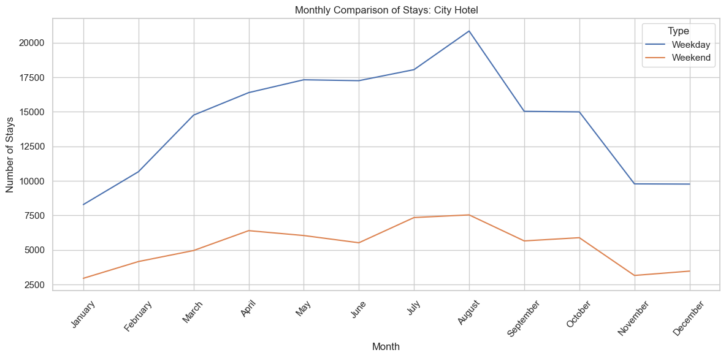
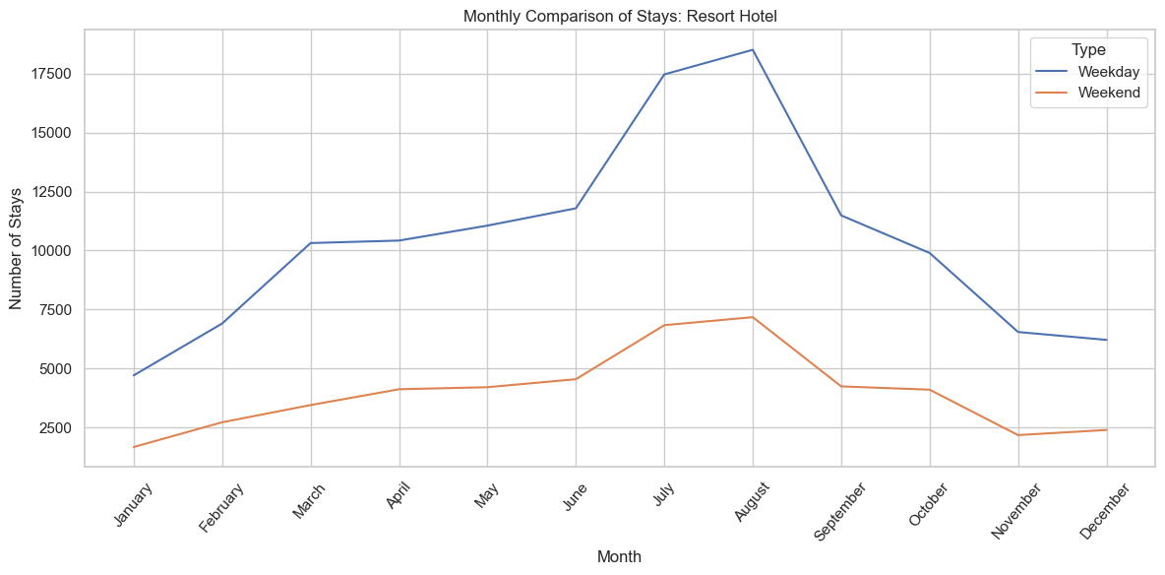

Slide 7
Monthly Comparison of Stays by Hotels
So with these two line graphs the idea was to display, similarly to the very first plot, and month to month comparison, but weekend to weekday stays by hotel. I thought because the code to make these graphs would be so similar I could lump the code for both in the same cell to share some code. The data for booking by day type here are nearly identical for both hotels.

Slide 8
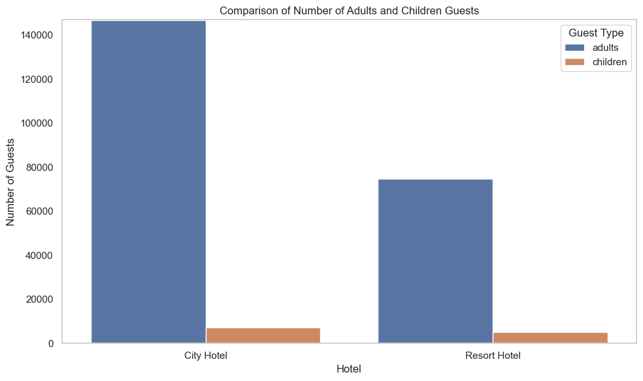

Slide 9
Comparison of Number of Adults and Children Guests
I saw the columns for adults and children and was curious to see some comparison there but the results were overwhelmingly for adults at both hotels. Way more overall volume of adults staying at the City Hotel.

Slide 10
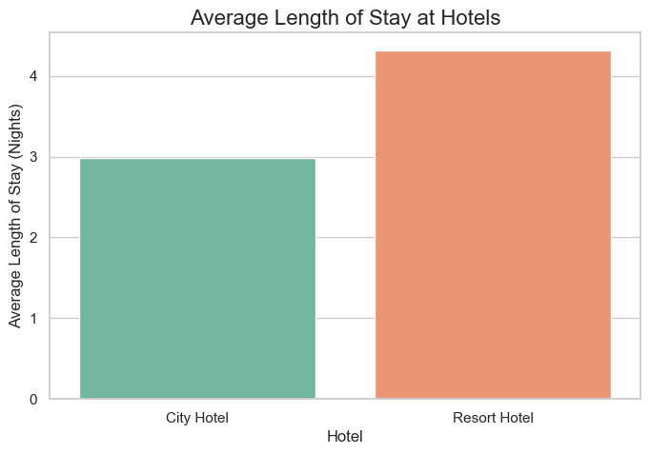

Slide 11
Average Length of Stays at Hotels
This plot was to see what the average length of stay was between the hotels. Although the City Hotel seems to have more people on average staying there people stay an average of a day longer at the Resort Hotel.

